Slide 1
Petrogenium.
Petrogenium.
…. because experience matters
January 2024

Slide 2
Petrogenium. Who are we?
Company:
  Founded in 2015, Head Office in Amsterdam, The Netherlands
  Petrogenium USA LLC set up in May 2021, now 25+ Associates
World-Class Expertise:
  Downstream Oil and Petrochemicals Industry
  Upstream & Mid-Stream Oil & Gas
  Sustainability & Renewable Resources
Global Reach:
  International world-class predominately ex-Shell technical, commercial and consultancy experts with 25+ years of oil industry experience in asset owner roles.
  150+ globally based consultants in EMEA, Americas and APAC
  40+ worldwide clients
Compelling Value Proposition and Broad Services Offerings:
  Technical and Operational support
  Business Improvement
  Strategy consulting

Slide 3
Petrogenium. Why work with us?
Unique selling point
  Access to a pool of top-tier world class industry experts, with best practices, industry standards, key performance metrics and leadership know-how
Cross-functional capabilities, experience, and credibility
  Hands-on approach to building trust and helping clients grow and develop
Experience of running the assets, which:
  Reduces risk
  Provides a higher return on investment
  Reduces time to value capture
An independent agnostic and external perspective
  No cross-selling of software, licensing or engineering services
A trusted advisor who can “walk the talk” from the C-suite to the operator
  We know what works, and more importantly, what doesn’t work
Fast response to client needs and resource shortages
Full capability - point solutions to integrated enterprise-wide outcomes

Slide 4
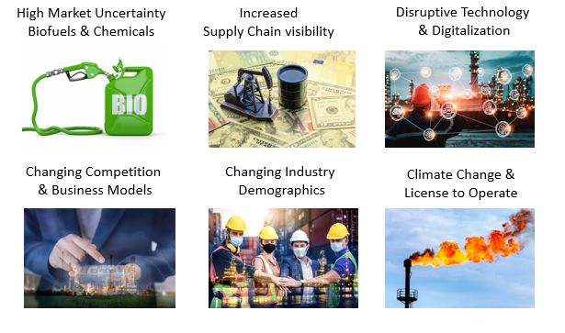
Petrogenium. What We Do.
Petrogenium provides support to ensure safe, reliable, profitable and sustainable business outcomes.
Strategy
  M&A
  Decarbonization
  Opportunity Realization
Business Improvement
  Site Assurance Reviews
  Margin Improvement
  Leadership & Organizational Capability
Technical & Operational
  Technical Specialist Support
  Operational Excellence
  Project Delivery
Industry Challenges and Opportunities

Slide 5
Petrogenium. How We Add Value.
Strategy
Business Improvement
Technical
& Operational
Merger & Acquisition
  Technical Due Diligence
  Transition Planning & Assurance
  Re-structuring support
Strategy Development
  Hydrocarbon and Asset Master Plan Development
Investment Planning
  Prioritization/Portfolio
  Opportunity Realization
  Value Assurance Review
Energy Transition
  Carbon Footprint Reduction
  Decarbonization
  CCS studies
  ‘Blue’ Hydrogen
  Biofuels
  Plastics Circular Economy
Management Systems
  Site Assurance Reviews
  Site Risk Management
HC Margin Improvement
  Tactical MI Reviews
  Configuration Studies
  Logistics Optimization
Business Planning
  Bus Planning Processes
  LP Model Review
  Margin Variance Analysis
Energy Management
  Energy/GHG Reduction Study
  Efficiency Roadmap
Measurement & Loss Control
  Mass Balance Assurance
  HC Loss Review
  Marine Witnessing
Leadership & Organization
  Organizational Health Check
  Mentoring & Coaching
  Interim Management
Technical Support - Many process & technical disciplines:
  Process unit reviews
  Troubleshooting
  Debottlenecking
  Catalyst performance
  Helpdesk Support
Training
  Technologist courses
  Process Safety
Digitalization & Control
  Digitalization Strategy
  Digitalization Value Delivery
  Advance Process Control
  Optimization
Process Safety
  RHA/HAZOP/LOPA
  Reactive Hazards
  Incident Investigation
  Root Cause Analysis
Project & Turnaround Mgmt
  Project Assurance Reviews
  Turnaround Assurance Reviews

Slide 6
Petrogenium. Technologies Supported.
Technical and Operational:
Health, (Process) Safety & Environment
Distillation
Catalytic Reforming, Isomerisation
(Residue) Catalytic Cracking
Visbreaking & Thermal Cracking
Hydro-treating / -cracking
Base Chemicals
Ethylene Oxide, Glycols, Solvents
Gas processing
Gas Treating and Sulphur Plants
Hydrogen manufacturing
Bitumen manufacturing
Utility Systems and Rotating Equipment
Combustion Processes
Water treatment and water management
Oil Movements
Product Quality, Laboratory & Blending
Corrosion engineering
Decontamination / Fouling
Business Improvement:
Supply & Economics
Oil-Chemical-Interface
Steam Cracker operational improvement
Planning, Scheduling, LP modelling
Investment Planning
HC Margin Improvement
Project Review
Product (depot) logistics
Energy & utilities systems
Energy efficiency improvement
Stock management
CO₂ benchmarking
Carbon Footprinting
Turnaround & Maintenance optimization
Effective Routine Maintenance operation
Operational Excellence
Integrity management
Start-up support
Staff (on-site) Coaching / Interim Management

Slide 7
Petrogenium. Putting the Client First.
Responding to the needs of the customer
Commercial traction
  Ramping up services and transitioning from Proof of Concept to a sustainable trusted advisor ‘delivery engine’, with reoccurring business
Proven business model
  Working successfully with IOCs, NOCs, and Independents
Collaborating with top management consultancies
  e.g. McKinsey, Bain & Co
Doing business with clients who believe what we believe, seeking;
  Genuine independent partners, with shared objectives
  A simple and coherent approach
  Open communication, with no bureaucracy
  Diversity and experience
  Advisors who fit well into their organisations
  Advisors they can trust

Slide 8
Petrogenium. Renewable Resources
Clients Benefit from:
Best practices from decades of asset operation in refining and petrochemical industry
Multi-disciplinary expertise: biofuels, catalysis, refining processes, chemistry, corrosion, fouling and metallurgy
Up-to-date independent expertise
Our services include (examples):
‘Roadmap to market’ support (from lab to commercial unit)
Technology assessment and technical due diligence
Analysis of existing processes and products and advise on improvements
Support investment decisions and value engineering:
  Quick scan and in-depth techno-economical assessment
  Feed, co-product and product pricing, valuation and supply chain design support
  Investment planning through deployment pipeline: ‘investment decision support’
10

Slide 9
Petrogenium. Customized Training.
Tailor made customized training, coaching or master classes
On location by target groups (operations, engineering, supervisors) and various knowledge levels (awareness, skill, mastery)
Petrogenium Training Catalogue available upon request
Performance Improvement
Introduction to Oil Refining (tech/ non-tech)
Hydrocarbon Economics and Upgrading
Hydrocarbon Loss & Accounting
Fuel Oil and Fuel Oil Blending
Operational Excellence
Operations Readiness Workshop
Structured Problem Solving & RCA
Project Management
Process Technologies
Distillation
Hydrotreating
Catalytic Reforming
Hydrocracking
Thermal Cracking
Energy & Utility Systems
Aromatics Recovery and Extractive Distillation
Amine Treating and Sour Water Stripping
Sulphur Recovery and Tail Gas Treating
Hydrogenation Technologies in Steam Crackers
QHSSE and Sustainability
Safety in Process Design
Root-Caused-Maintenance (RCM)
Fuels Quality Management
Corrosion Control in Crude Units
Critical Overview of renewable Resources

Slide 10


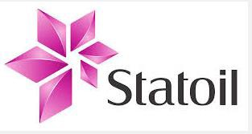


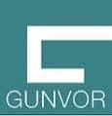

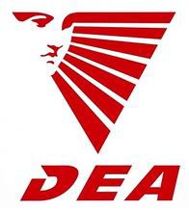









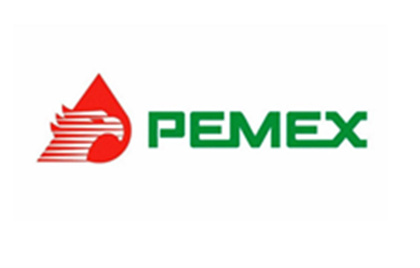

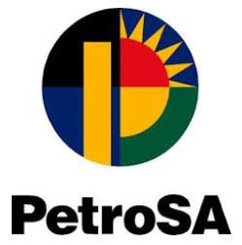

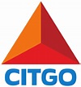






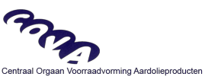


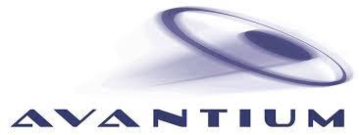





Petrogenium. Recent Global Clients.
PMI Norteamérica

Slide 11
Petrogenium.
… because experience matters
Contact: Petrogenium B.V.
Tammo Beishuizen, Managing Partner
M: +31 (0) 634 36 55 55
O: +31 (0) 235 83 08 91
E: tammo.beishuizen@petrogenium.com
Petrogenium USA LLC
Paul Newman, President
M: +1 713 715 9920
O: +31 (0) 235 83 08 91
E: paul.newman@petrogenium.com
Stefan Kardos, Partner
M: +31 (0) 639 88 65 84
O: +31 (0) 235 83 08 91
E: stefan.kardos@petrogenium.com

Slide 12
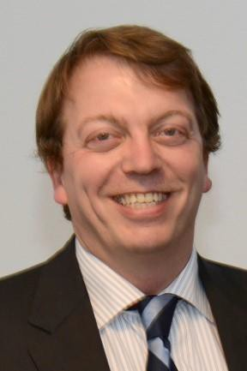
Tammo Beishuizen, Managing Partner
Experience Summary
Tammo is a seasoned entrepreneur and experienced manager with a diverse track record in the international oil, petrochemicals manufacturing and consulting business.
Building on 25+ years of experience in the downstream oil asset operation, in process engineering, supply chain planning, capital projects business development and consultant roles with major international oil companies (BP, Shell) and leading engineering contractor companies (Stork, Jacobs), he understands exactly what customers want.
He is specialized in designing service programs that deliver bottom-line impact and creating tangible value for our customers. Besides being the Managing Partner of Petrogenium, he enjoys to lead projects in the areas of hydrocarbon margin improvement and benchmarking.
Prior to founding Petrogenium, he was Founding Partner of a on Downstream Refining specialized consulting company. He has broad experience with customers in Europe, Russia, the Middle East and Africa.
Credentials
MSc Mechanical Engineering, Delft University, the Netherlands, 1991
Areas of Specialization
Benchmarking Strategic Studies, Service Management, Investment Planning, Technical Due Diligence, Business Improvement Programs, Hydrocarbon & Energy Management, Implementation

Slide 13
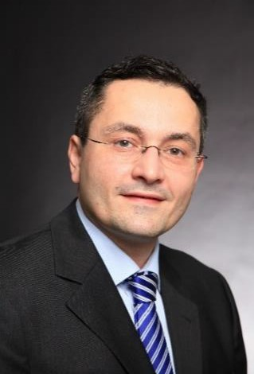
Stefan Kardos, Partner
Experience Summary
Stefan's passion is supporting clients to solve technical and hydrocarbon supply chain challenges arising during operations, at a refinery, petrochemicals site or a supply organization.
During his professional career he built-up deep expertise in Oil Movements, Hydrocarbon
Supply & Logistics and Light Ends conversion processes.
He has reached this level of expertise by working for Shell and other consulting firms in various international roles in technology, operations and consultancy. He joined Petrogenium as Practice Leader Oil Movement, Hydrocarbon Supply & Logistics in 2016.
He has been involved in the basic and detailed design of many oil movements facilities, Light Ends unit troubleshooting, maintenance and implemented various improvement projects for operational excellence, availability, inventory management and margin.
Besides his deep technical knowledge, Stefan is trained in business, economics and operations research. He applied this knowledge in broader consultancy studies for Shell, Shell Joint Ventures and commercial IOC and NOC clients globally.
Credentials
MBA, Rotterdam School of Management, the Netherlands, 2010
MSc Process Engineering, TU-Bergakademie Freiberg, Germany, 2002
Areas of Specialization
All round top level managing consulting and technical support, Hydrocarbon Supply & Logistics Optimization, Working Capital Optimization, Operational Excellence, Process Design and Service Management

Slide 14
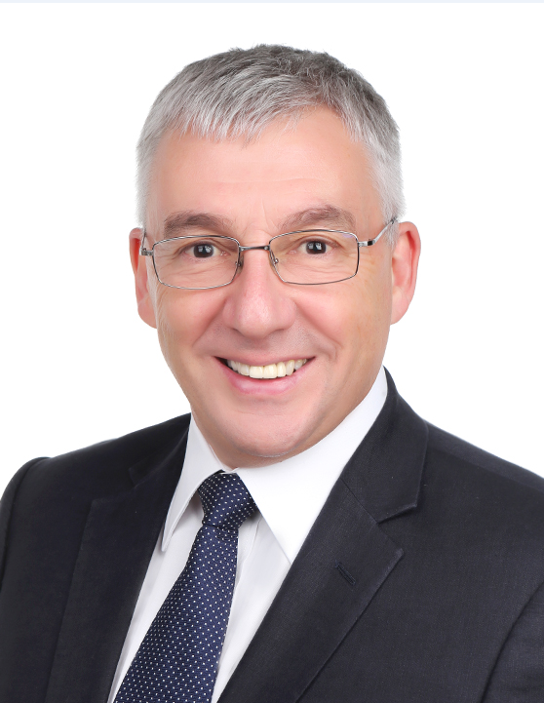
Paul Newman, President Petrogenium USA LLC
Experience Summary
35 years at Shell; 25 years Downstream Manufacturing Refining & Petrochemicals, including 10 years with Shell Global Solutions Consultancy servicing Shell, Joint Ventures and external clients
2 years as a Senior Advisor to Bain & Company’s Oil & Gas Practice
2 years as an Executive Coach for Leadership Development with Reliance Industries
3 years KBC Advanced Technologies Global Consulting leadership delivering sustainable customer value using digital transformation.
Credentials
Loughborough University of Technology, UK, BSc First Class (Hons) in Chemical Engineering & Management
Member of the Institution of Chemical Engineers Professional Formation Forum (PFF), assessing whether individuals seeking membership meet the standards set down by the Council. A Career Professional Development (CPD) assessor appointed by the Chair of the PFF.
Certified Myers-Briggs MBTI® practitioner.
Areas of Specialization
Cross-functional competency in Digital Transformation, Operational Excellence, Hydrocarbon Management, Asset & Integrity Management, Flawless Start-Up, Site Transformation, Programme & Change Management, Site Performance Assessment, Energy Management, Health, Safety and Environment, Human Resources Management, Staffing and Organisational Efficiency, Competency Development and Assurance, Coaching and Mentoring.

